Slide 1



A Smalltalk on Singularity and Containers
CRUNCH GROUP
Brown University

Slide 2

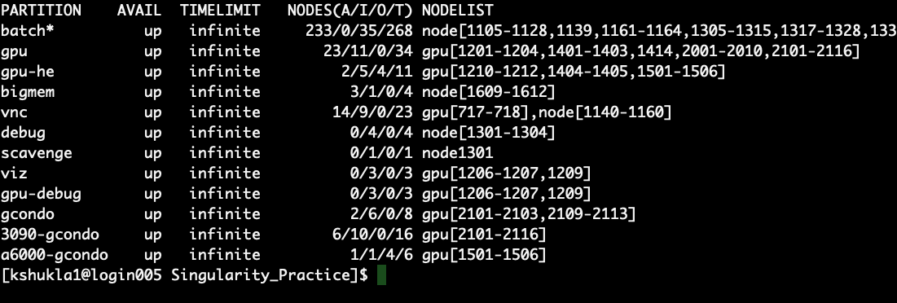
Why this (Pep)Talk?
Python 3.8 does not support TensorFlow 1.*
New GPUs on Oscar 3090-gcondo and a6000-gcondo are of Ampere Architecture and does not support < cuda11 and < cudann 8.0
Old GPUs gcondo does not support CUDA11.
sinfo –s # Try

Slide 3
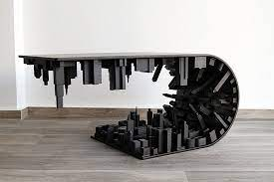
What is Containers and Singularity?
A container facilitate to put an application and all of its dependencies into a single package: Plug and Play * (EK)
Container makes your code portable, shareable, and reproducible.
Containers foster portability and reproducibility because they package ALL of an applications dependencies including its own tiny operating system!
This means your application won't break when you port it to a new environment. Your app brings its environment with it.
For reproducing result of your research paper, include a link to a container with all of the data and software that you used so that others can easily reproduce your results

Slide 4
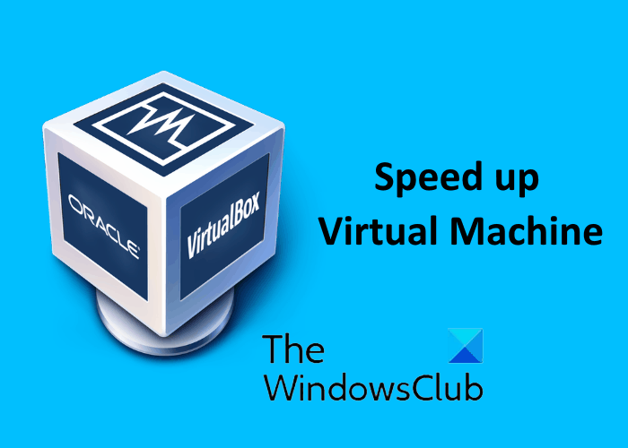
Containers versus Virtual Machine
Install every last bit of an operating system (OS) right down to the core software that allows the OS to control the hardware (called the kernel).
VMs are slow and resource hungry. You start a VM it has to bring up an entirely new OS.
Not Flexible as VM. A Linux container must be run on a Linux host OS. (Although you can mix and match distributions.) In practice, containers are only extensively developed on Linux.
Much faster and lighter weight than VMs. Just a few MB.
Start and stop quickly and are suitable for running single apps.

Slide 5
Few Words about Singularity
Singularity is a new container software invented by Greg Kurtzer while at Lawrence Berkley National labs.
Now developed by his company Sylabs.
It was developed with security, scientific software, and HPC systems in mind.

Slide 6
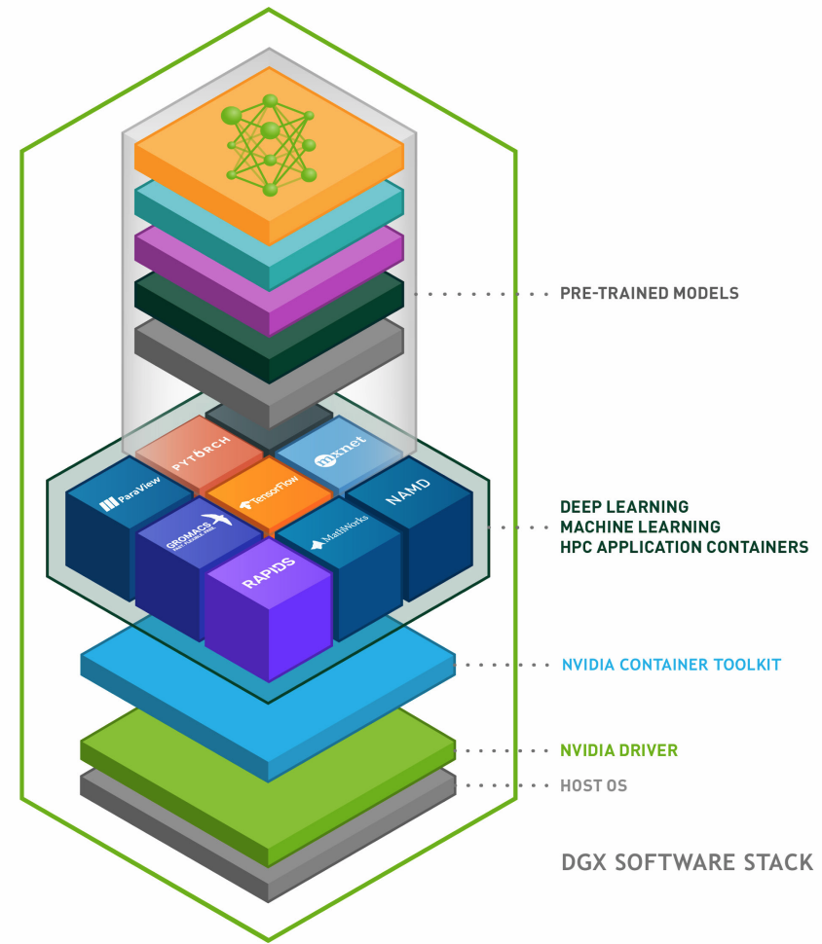
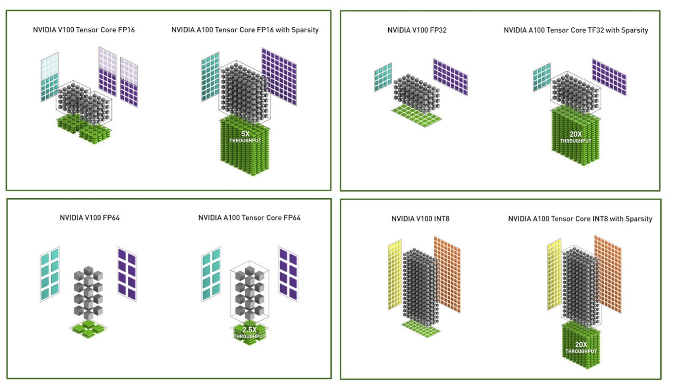
NVIDIA A100 GPU Verticals and Tensorcores

Slide 7
Lets build the Image for TensorFlow
Go to NVIDIA NGC Container:
https://catalog.ngc.nvidia.com
On Login node
singularity build crunch_tf2.simg docker://nvcr.io/nvidia/tensorflow:21.12-tf2-py3
Get a GPU:
interact –q 3090-gcondo –n 8 –g 1 –m 32g –t 1:00:00
Get A Singularity Shell
singularity shell -B /gpfs/scratch,/gpfs/data --nv crunch_tf2.simg
Or Export File system as Using Singularity variable:
export SINGULARITY_BINDPATH="/gpfs/scratch,/gpfs/data”
singularity shell–nv crunch_tf2.simg

Slide 8
Lets Run a Code: interact mode
IEEE-754
SIGN
Range
Precision
Floating Point: FP32:
1.57 = 0 011 1111 1100 1000 1111 0101 1100 0011
Stored Value in Comp: 1.57000005245208740234375
1.57 = 0 011 1111 1100 1000 11 11 0101 1100 0011
1.57 = 0 011 1111 1100 1000 11 11 0101 1100 0011
1.57 = 0 011 1111 1100 1000 1111 0101 1100 0011
1 BIT
8 BITS
23 BITS
SIGN
Range
Precision
TensorFlow32: TF32
1 BIT
8 BITS
10 BITS
SIGN
Range
Precision
Float16: FP16
Half Precision
1 BIT
5 BITS
10 BITS
SIGN
Range
Precision
BFLOAT16:
1 BIT
8 BITS
7 BITS

Slide 9
2x
In case you want to see detail

Slide 10
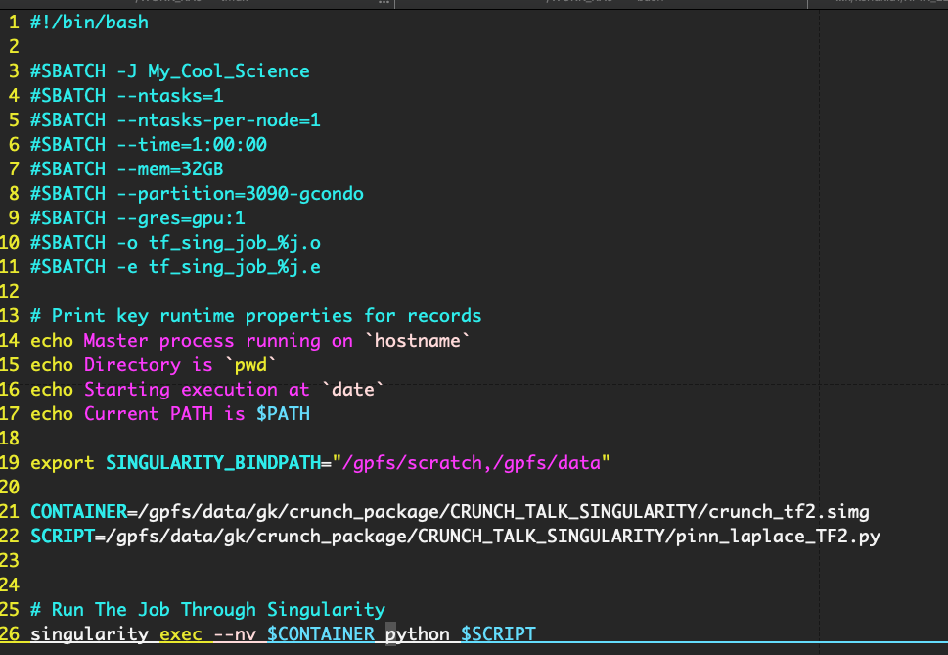
Scheduling Job through Container

Slide 11
Lets build the Image for PyTorch
Go to NVIDIA NGC Container:
https://catalog.ngc.nvidia.com
On Login node
singularity build crunch_pytorch.simg docker://nvcr.io/nvidia/pytorch:21.12-py3
Get a GPU:
interact –q 3090-gcondo –n 8 –g 1 –m 32g –t 1:00:00
Get A Singularity Shell
singularity shell -B /gpfs/scratch,/gpfs/data --nv crunch_pytorch.simg
Or Export File system as Using Singularity variable:
export SINGULARITY_BINDPATH="/gpfs/scratch,/gpfs/data”
singularity shell–nv crunch_tf2.simg

Slide 12
How about NekTar++:
Go to NVIDIA NGC Container:
singularity build nektar.simg docker://nektarpp/nektar
On Login node
singularity shell -B /gpfs/scratch,/gpfs/data/ nektar.simg
> NekMesh

Slide 13
Future Topic(s)
Virtualizing Your Own Code and develop a container for that.
Please feel free to roll your ideas and requirements.
Acknowledgement
Prabhjyot Singh Saluja, CCV, Brown University

Slide 14
Thank You!
Happy Computing!

